Slide 1

The California Charter
Authorizing Professionals
Webinar Series
COVID-19 Update #4
Planning for Success
Notes:
Victor

Slide 2
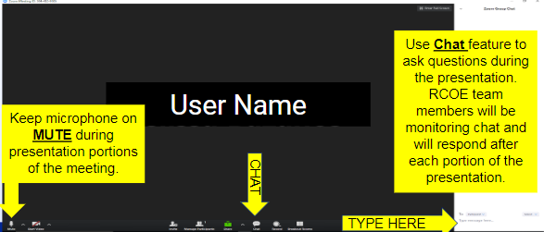

Zoom Functionality
CCAP
Notes:
Victor

Slide 3
About CCAP
Founded by a group of committed authorizers with a mission to advance quality public education for all students
National Dissemination Grant recipient from the U.S. Department of Education’s Office of Innovation to improve charter school authorizing best practices partnering with Colorado and Florida
Notes:
Victor

Slide 4





For Today
Notes:
Corey

Slide 5
Take Away for Today
National and Federal Updates
Legal Update
Planning: Now and future

Slide 6
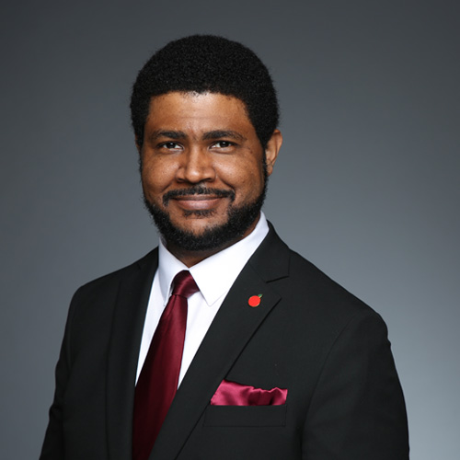
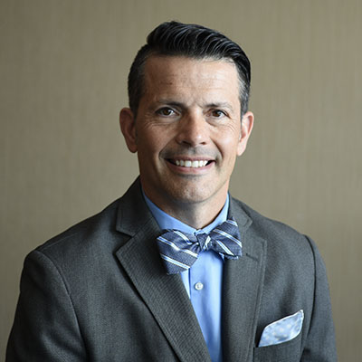

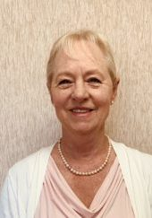
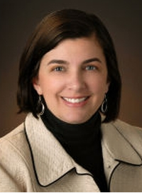
Speakers
Edward J. Sklar,
Legal Counsel
Dr. Corey Loomis, VP CCAP/ RCOE Charter Schools Unit Director
Dr. Karega Rausch
NACSA, Vice President of Research and Evaluation & Acting President and CEO
Debi Deal,
CCAP Secretary/
Fiscal Consultant
Dr. Kathleen Hermsmeyer, Superintendent, Springs Charter School
Notes:
Corey- intros

Slide 7




Authorizers’ Role
Notes:
Corey

Slide 8


What’s the new target?

Slide 9
Dr. Karega Rausch
NACSA, Vice President of Research and Evaluation & Acting President and CEO
Notes:
Corey- intros

Slide 10
NATIONAL/FEDERAL updates
IDEA
Florida Waiver
Emergency Education Stabilization Fund
Virtual Learning & Internet Access

Slide 11
Planning for THE FALL
Recent resource on fall re-opening: https://www.aei.org/wp-content/uploads/2020/05/A-Blueprint-for-Back-to-School.pdf
Key Areas
  Operations – Health Accommodations, Meals, Transportation
  Whole Child Supports
  School Personnel
  Academics – Continuity of Learning Plans, Schedules & Learning Time, Assessments & Accountability
  Distance Learning
Plan for 2020-21 and 2021-22 school years (current evidence suggests vaccine not available for widespread use in 18 months or longer)

Slide 12


Slide 13
Legal Update
Edward J. Sklar,
Legal Counsel
Notes:
Corey- intros

Slide 14
A Lawyer’s thoughts:
Grading / Graduation Requirements: What are your charter schools doing?
Executive Order N-56-20 — New dates for LCAP and Budget
Executive Order N-29-20 — Brown Act

Slide 15
What if they started the school year early and the teachers didn’t come? Union vs. non-union workplaces
Ironies of ironies: The non-classroom based charter moratorium

Slide 17
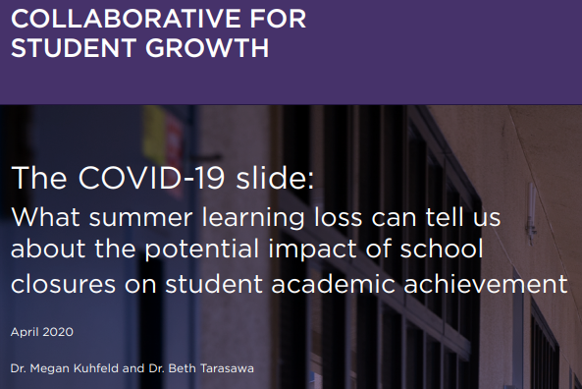
NWEA April Brief

Slide 18
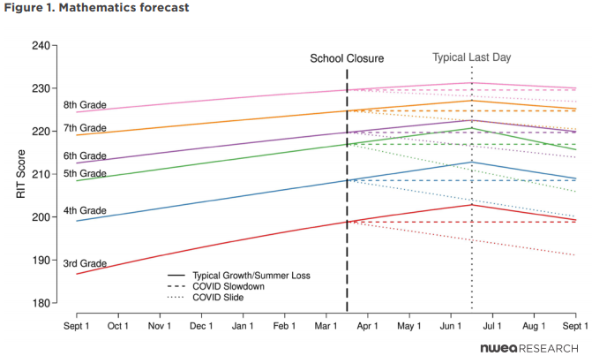
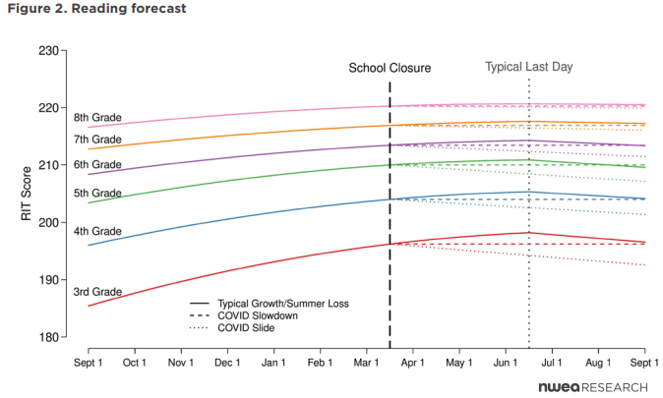
50% Retention
70% Retention

Slide 19
Charter perspective
Dr. Kathleen Hermsmeyer, Superintendent, Springs Charter School

Slide 20
Charter perspective
What type of planning has your network done during COVID 19?
What type of planning are you doing for next school year?
What has been the biggest challenges?
What would you want authorizers to know?

Slide 21


Slide 23
Planning for Success
Dr. Corey Loomis, VP CCAP/ RCOE Charter Schools Unit Director
Notes:
Corey- intros

Slide 24
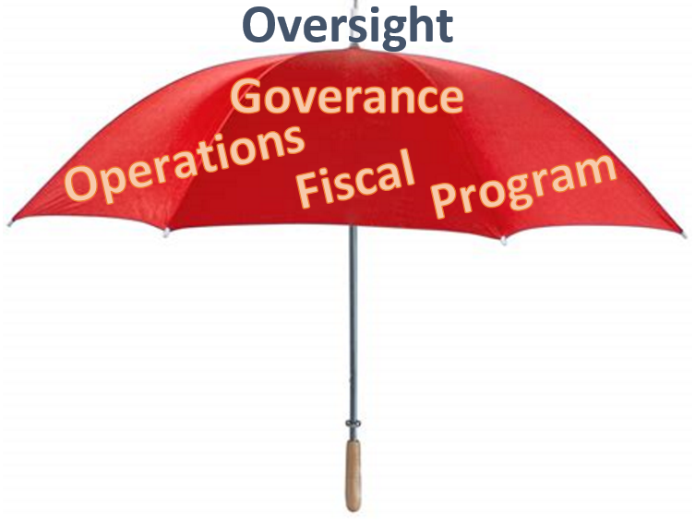
Regular oversight vs. COVID 19 oversight

Slide 25
What is reasonable COVID 19 oversight?
Executive Order N-26-20: Ensuring funding to support: 1) Deliver high-quality education opportunities; 2) Provide school meals; 3) Provide supervision; 4) Pay employees
Executive Order N-29-30: Parts of Brown Act suspended: Can meet virtually and outside of district/ boundaries; not required to post residence address; Must provide and post on webpage virtual/ telephonic access; Must follow 72 hrs posting.
Executive Order N-30-20: Suspension of State assessments
Executive Order N-56-20 (4/23) LCAP changes: 1) LCAP December 15 extension; 2) “Written report” and budget approved and submitted July 1, 2020; 3) Written report submitted to authorizers AND County Superintendent by July 1 (EDC 47604.33); 4) Written report posted on school’s homepage on the internet.

Slide 26
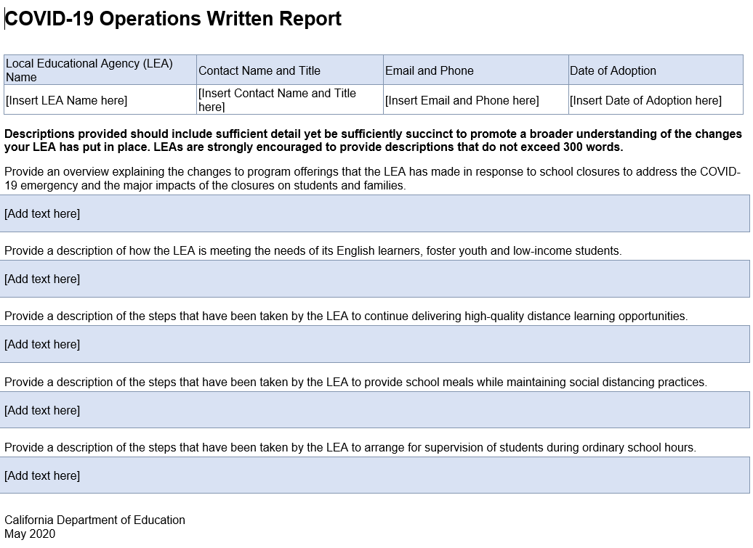

Slide 27
N-56-20 “Operations Written Report”
Summary includes:
    Changes to program offerings that the LEA made in response to school closures to address COVID-19 emergency and major impacts
    A description of how the LEA is meeting the needs of unduplicated pupils during school closures, and
    The steps taken by the LEA consistent with EO N-26-20 to support:
      Delivering high-quality distance learning opportunities;
      Providing school meals in non-congregate settings; and
      Arranging for supervision of students during ordinary school hours.
  Adopted at the same meeting at which the local governing board adopts the annual budget.

Slide 28
N-56-20 “Operations Written Report” (cont’d)
  No public hearing requirement for the “written report to the community.”
  Budget and “written report to the community” must be adopted during the same meeting.
  Charter school submits to its authorizer.
  All LEAs posts “written report” on the homepage of website.

Slide 29
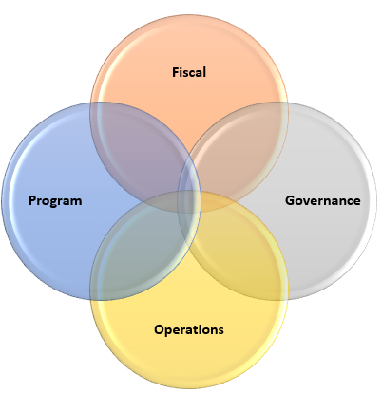

Slide 30
Fiscal planning and oversight
Debi Deal
CCAP Board Member/
Fiscal Consultant
Notes:
Corey- intros

Slide 31
What History Told Us
How State Budget Reacts With Economic Changes
CA State Budget
Personal Income Tax
Corporate Taxes
Sales Taxes
Notes:
Debi

Slide 32
Volatility of the State Budget
When any one of these taxes drop, there are impacts to the state budget which impacts K-14.
When all three drop, we are in for a bumpy ride, so fasten your seat belts!
The downward trajectory is quick, recovery is slow, and the impact will be more difficult.
Notes:
Debi

Slide 33
Don’t Forget Your
CDE Waivers
Federal Waivers and flexibility webinar and slides.
Waiver information CDE
Notes:
Ed

Slide 34
The Future
  Budgeting for 2020-21 and beyond will involve MAJOR uncertainty. Assumptions will change as information is known.
  Developing a baseline budget – just the basics and prepare multiple assumption models.
  Adjust assumptions; plan for zero COLA and cash deferrals.
  The new provision of the 2019-20 Budget Act:
    K-12 Autofit Provision will most likely be implemented – allows the Director of Finance to “autofit” the LCFF COLA to “fit” the minimum guarantee.
  Cash flow management will be critical for charter schools because there is no “hold harmless” provision and no state loans. Build cash reserves as quickly as possible.
Notes:
Debi

Slide 35

Wrapping Up the Year
Book CARES ACT and SB 117 revenues
Calculate areas of savings: Substitute costs, overtime, extra time, NPA services, utility costs
Adjust for unusual costs: Custodial cleaning supplies, overtime for M&O
Build reserve levels – especially cash!
Plan for ZERO COLA for 2020-21 and 2021-22
Notes:
Debi

Slide 36
Authorizing Guidelines to Charters
Consider :
  Develop a unified message to all charter schools for budget assumptions.
  Ensure charters know about the waivers and timelines.
  Plan for an economic downturn.
  Train charters on cash flow management.
Notes:
Debi

Slide 37
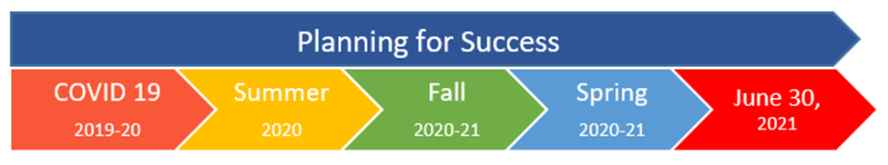



Slide 38
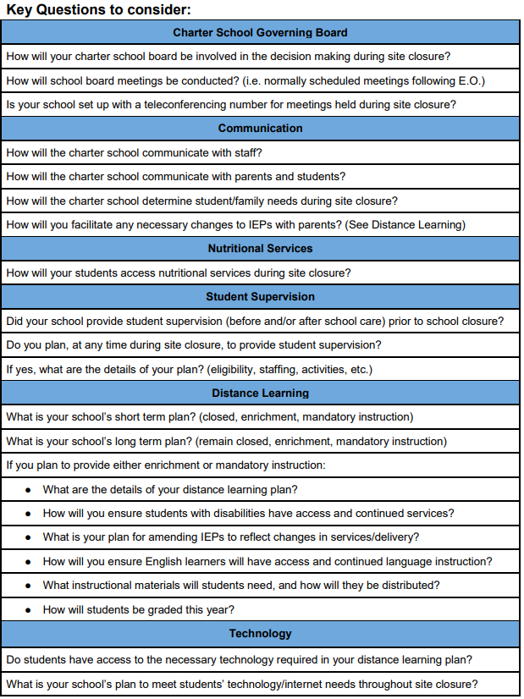
Key Questions to Consider 1.0
KQ 2.0 coming soon!

Slide 39


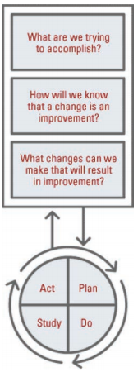


Continuous Improvement

Slide 40


Notes:
Corey

Slide 41
Next Steps and Resources
Stay Tuned!
    CCAP Library
    “Office Hours”
    Next update week of May 18th
    In case you missed - Cash-flow Training 4/27/20 webinar
Notes:
Victor

Slide 42
Speakers
Edward J. Sklar,
Legal Counsel
Dr. Corey Loomis, VP CCAP/ RCOE Charter Schools Unit Director
Dr. Karega Rausch
NACSA, Vice President of Research and Evaluation & Acting President and CEO
Debi Deal,
CCAP Secretary/
Fiscal Consultant
Dr. Kathleen Hermsmeyer, Superintendent, Springs Charter School
Notes:
Corey- intros

Slide 43

Thank you!

